Slide 1
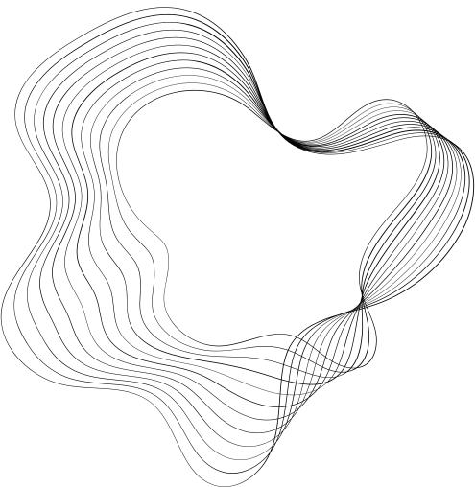

DATA STRUCTURE
SELECTION SORT
23ISR048 - RITVIK T G
23ISR019 - JAGHADEEP S N
23ISR042 - PRANESH B R

Slide 2
PROBLEM STATEMENT
Sorting a List of Names Using Selection Sort
Given an unsorted list of names, and the task is to sort this list in alphabetical order using the Selection Sort algorithm. The Selection Sort algorithm will repeatedly select the smallest name from the unsorted portion of the list and move it to the beginning of the sorted portion until the entire list is sorted.

Slide 3
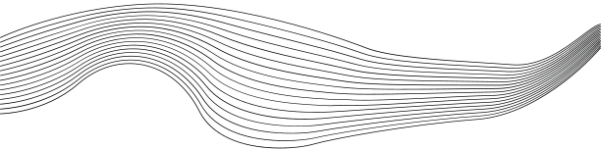
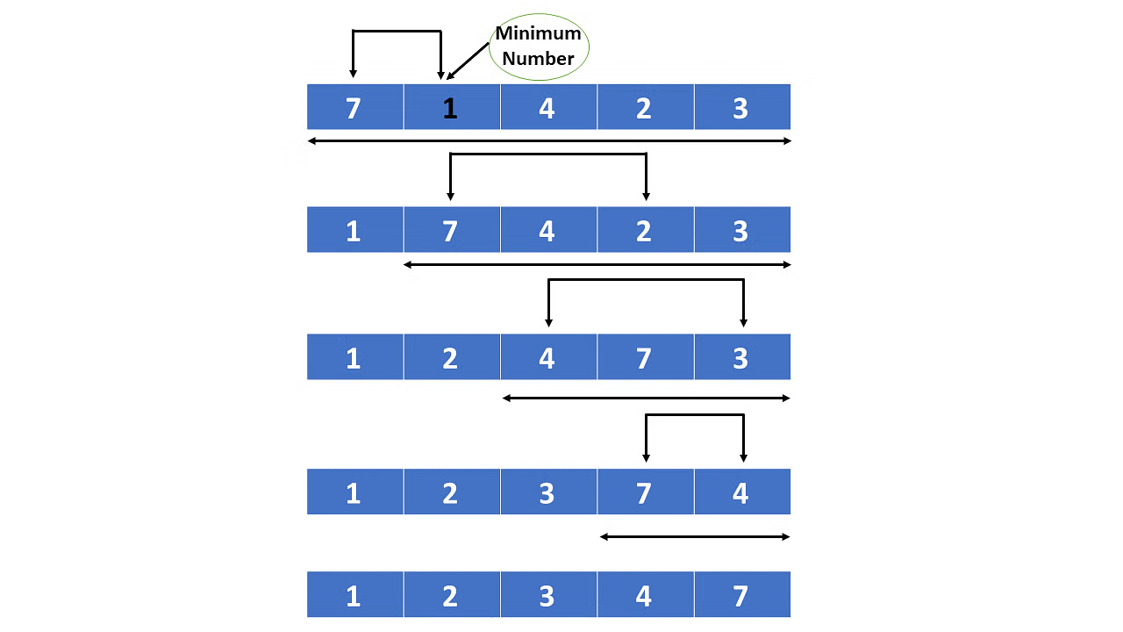
INTRODUCTION
Selection sort is a simple and efficient sorting algorithm that works by repeatedly selecting the smallest (or largest) element from the unsorted portion of the list and moving it to the sorted portion of the list.
Selection Sort is not very efficient for large lists due to its O(n^2) time complexity. It is best suited for small datasets or educational purposes.

Slide 4

DATA STRUCTURE
The type of Data structure is Array.
Array :
Array is a collection of Similar datatype elements.
It’s a Linear Data Structure.
Arrays are used for storing lists of items, such as a list of numbers or a collection of objects. They are fundamental in many algorithms and data structures.

Slide 5

LANGUAGES
HTML
HTML stands for HyperText Markup Language.
It's the standard language used to create and design webpages..
CSS
CSS stands for cascading style sheets.
CSS is the language that is used to style HTML documents.

Slide 6
JAVASCRIPT
JavaScript is a lightweight, cross-platform, single-threaded, and interpreted compiled programming language.
It is also known as the scripting language for webpages.
DOM
DOM (Document Object Model) is a hierarchical representation of HTML documents.
It defines the structure and properties of elements on a webpage.

Slide 7
CODING
<!DOCTYPE html>
<head>
<meta charset="UTF-8">
<title>Selection Sort </title>
<style>
body {
display: flex;
flex-direction: column;
justify-content: center;
align-items: center;
height: 100vh;
margin: 0;
font-family: Arial, sans-serif;
background-color: #262823;
}
h1 {
margin: 20px;
font-size: 24px;
color: #fdd648;
}
.controls {
margin-bottom: 20px;
}
input[type="text"] {
margin: 20px;
}
padding: 8px;
margin-right: 10px;
width: 200px;
border: 1px solid #ccc;
border-radius: 4px;
}
button {
padding: 8px 16px;
margin: 0 5px;
background-color: #a35501;
color: white;
border: none;
border-radius: 4px;
cursor: pointer;
}
button:disabled {
background-color: #c2c2c2;
cursor: not-allowed;
}
.container {
display: flex;
flex-wrap: wrap;
justify-content: center;
gap: 10px;
margin: 20px;
}

Slide 8
.name-block {
padding: 10px 20px;
background-color: #4e84b0;
color: white;
border-radius: 4px;
font-size: 16px;
transition: background-color 0.4s, transform 0.4s;
}
.name-block.active {
background-color: #e74c3c;
}
.name-block.min {
background-color: #f39c12;
}
</style>
</head>
<body>
<h1>Selection Sort: Sorting List of Names</h1>
<div class="controls">
<input type="text" id="nameInput" placeholder="Enter a name" />
<button onclick="addName()">Add Name</button>
</div>
<div class="container" id="nameContainer"></div>
<button id="sortButton" onclick="startSorting()">Start Sorting</button>
<script>
let names = [];
let isSorting = false;
const nameContainer = document.getElementById('nameContainer');
const sortButton = document.getElementById('sortButton');
function createNameBlocks() {
nameContainer.innerHTML = '';
names.forEach(name => {
const nameBlock = document.createElement('div');
nameBlock.className = 'name-block';
nameBlock.textContent = name;
nameContainer.appendChild(nameBlock);
});
}
function addName() {
if (isSorting) return;
const nameInput = document.getElementById('nameInput').value.trim();
if (nameInput) {
names.push(nameInput);
document.getElementById('nameInput').value = '';
createNameBlocks();
}
}
async function selectionSort() {
const nameBlocks = document.querySelectorAll('.name-block');
for (let i = 0; i < names.length - 1; i++) {
let minIndex = i;

Slide 9
nameBlocks[i].classList.add('active');
for (let j = i + 1; j < names.length; j++) {
nameBlocks[j].classList.add('active');
if (names[j] < names[minIndex]) {
nameBlocks[minIndex].classList.remove('min');
minIndex = j;
nameBlocks[minIndex].classList.add('min');
}
await new Promise(resolve => setTimeout(resolve, 500));
nameBlocks[j].classList.remove('active');
}
if (minIndex !== i) {
[names[i], names[minIndex]] = [names[minIndex], names[i]];
createNameBlocks();
}
nameBlocks[i].classList.remove('active');
nameBlocks[minIndex].classList.remove('min');
}
}
async function startSorting() {
if (names.length === 0) return;
isSorting = true;
sortButton.disabled = true;
await selectionSort();
sortButton.disabled = false;
isSorting = false;
}
createNameBlocks();
</script>
</body>
</html>

Slide 10
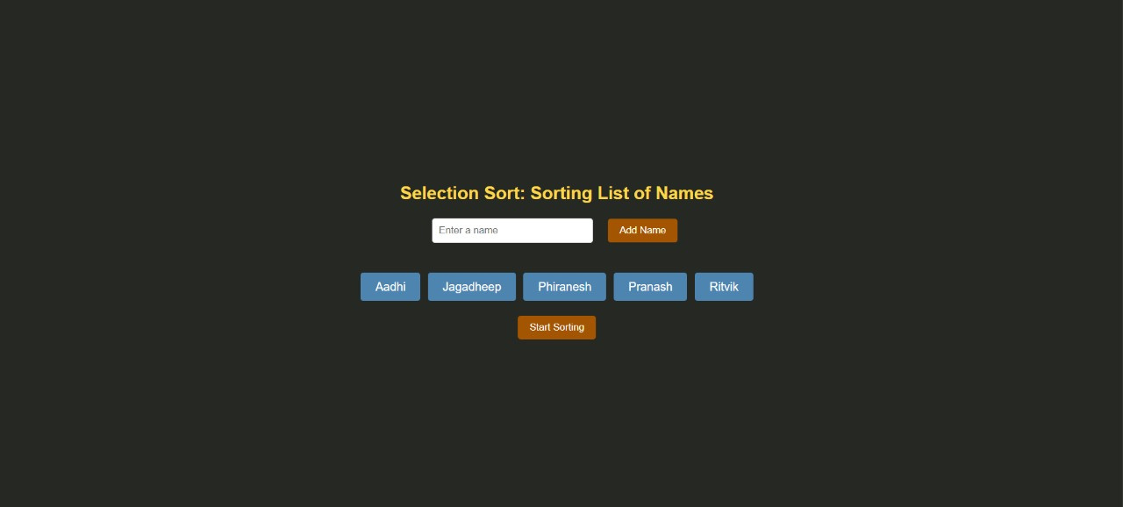
OUTPUT

Slide 11
GITHUB ID
RITVIK T G https://github.com/Ritivktg
PRANASH B R https://github.com/pranesh-ramesh
JAGHADEEP S N https://github.com/Jaghadeep-345

Slide 12

THANK YOU

